Slide 1

CI/CD PIPELINE

Slide 2
Team
PRASHANT PRABHU KARIYANNAVAR
ADITYA R GAWALI
JUHI R PATIL

Slide 3

What is DevOps?
Official definition by AWS : DevOps is the combination of cultural philosophies, practices, and tools that increases an organization’s ability to deliver applications and services at high velocity: evolving and improving products at a faster pace than organizations using traditional software development and infrastructure management processes
Aims is to makes easy and shorten the systems development life cycle.
Combine Software Development and IT Operations.
Agile Methodology Aspects

Slide 4
What is CI/CD?
Combine Practices of Continuous Integration(CI) and Continuous Delivery or Deployment.
Bridges the gaps between development and operation activities.
Official Definition of Continuous Integration – Continuous Integration (CI) is a development practice that requires developers to integrate code into a shared repository several times a day. Each check-in is then verified by an automated build, allowing teams to detect problems early..
Continuous Delivery – is the practice of keeping your software releasable at all times through automation of quality, security and deployment processes across the software delivery lifecycle.

Slide 5
Why CI/CD?
Fast delivery
Deliver software to a production environment with speed, safety and reliability.
Automation of build and testing process
Smaller Code Changes
Fault isolations are faster to detect
Faster release date by keeping the code in a release-ready state
Easy Maintenance and Updates

Slide 6
CI/CD Architectural Flow
Code
CI Pipeline
Build
CD Pipeline
Review
Source Commit <>
Unit Tests
Integration Tests
Compile
Docker build
Deploy
Staging
Production

Slide 7
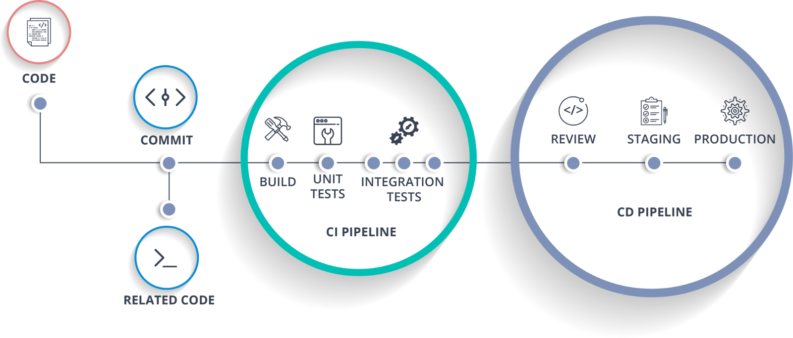

Slide 8
Technologies/Tools
Git – Version Control
Spring Boot – Microservice
Jenkins – CI/CD
Docker – Containerization
Docker Hub – Docker image Repository
Kubernetes - Orchestration

Slide 9
Version Control
GIT
Version control helps a software team manage changes to source code over time. Version control software keeps track of every modification to the code in a special kind of database.
If a mistake is made, developers can turn back the clock and compare earlier versions of the code to help fix the mistake while minimizing disruption to all team members.

Slide 10
Micro-service
SPRING BOOT
Architectural style that structures an application as a collection of services that are:
-Highly maintainable and testable
Loosely Coupled and Independently deployable
-Organized around business capabilities

Slide 11
Continuous Integration/ Continuous Deployment
Jenkins
The user interface is simple and intuitive
Extremely flexible and easy to adapt to your purposes
It has over 1000 plugins supporting communication, integration, and testing to numerous external applications and if the plugin is not available, you can easily create one.
It has a simple configuration through a web-based GUI, which speeds up job creation, improves consistency and decreases the maintenance costs.
Allows consistent scripting across operating systems.
The Jenkins tool is written in Java and thus it can be portable to most of the major platforms.

Slide 12
Containerization
DOCKER
Containerization is increasingly popular because containers are:
Flexible: Even the most complex applications can be containerized.
Lightweight: Containers leverage and share the host kernel.
Interchangeable: You can deploy updates and upgrades on-the-fly.
Portable: You can build locally, deploy to the cloud, and run anywhere.
Scalable: You can increase and automatically distribute container replicas.
Stackable: You can stack services vertically and on-the-fly.

Slide 13
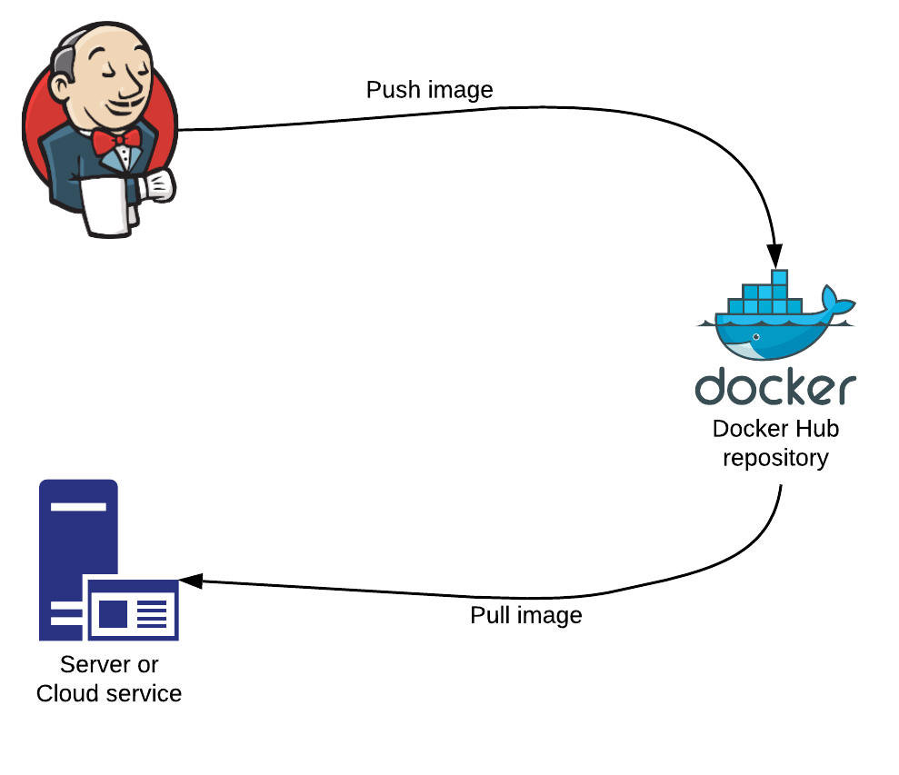
Docker Hub

Slide 14
Orchestration
KUBERNETES
Container orchestration is the automatic process of managing or scheduling the work of individual containers for applications based on microservices within multiple clusters.
Container orchestration is focused on managing the life cycle of containers and their dynamic environments.
Kubernetes orchestration allows you to build application services that span multiple containers, schedule containers across a cluster, scale those containers, and manage their health over time.

Slide 15

DEMO

Slide 16

Future Scope

Slide 17
Future Scope (Contd..)
DevOps is becoming an industry standard for many businesses.
According to a report issued by Capgemini, 60% of businesses either adopted DevOps or planned to do so during 2018.
Lately, microservices and DevOps are synonymous with each other. When you need an architectural approach to building applications, microservices provide this solution. Because microservices provide an architectural framework that is loosely coupled and distributed, the entire app won’t break when one team makes changes.

Slide 18
References
https://analyticsindiamag.com/5-reasons-why-jenkins-is-the-most-used-open-source-tool-by-developers/
https://blog.iron.io/what_is_the_future_of_devops/

Slide 19

Questions?

Slide 20

Thank You

